Slide 1
Behavioral Patterns part -II
Emre Kaplan, Ph.D.

Slide 2
Behavioral Patterns
Behavioral patterns are concerned with algorithms and the assignment of responsibilities between objects.
Behavioral patterns describe not just patterns of objects or classes but also the patterns of communication between them.
These patterns characterize complex control flow that's difficult to follow at run-time. They shift your focus away from flow of control to let you concentrate just on the way objects are interconnected.
Behavioral object patterns use object composition rather than inheritance.
Source: Erich Gamma, Richard Helm, Ralph Johnson, and John Vlissides. 1995. Design Patterns: Elements of Reusable Object-Oriented Software. Addison-Wesley Longman Publishing Co., Inc., Boston, MA, USA.

Slide 3
Behavioral Patterns
Behavioral Patterns
Template Method
Observer
Null Object
Iterator
State
Mediator
Strategy
Command
Visitor
Chain of Responsibility
Memento
Dependency Injection

Slide 4
Iterator Pattern
Intent
The Iterator Pattern provides a way to access the elements of an aggregate object sequentially without exposing its underlying representation.

Slide 5
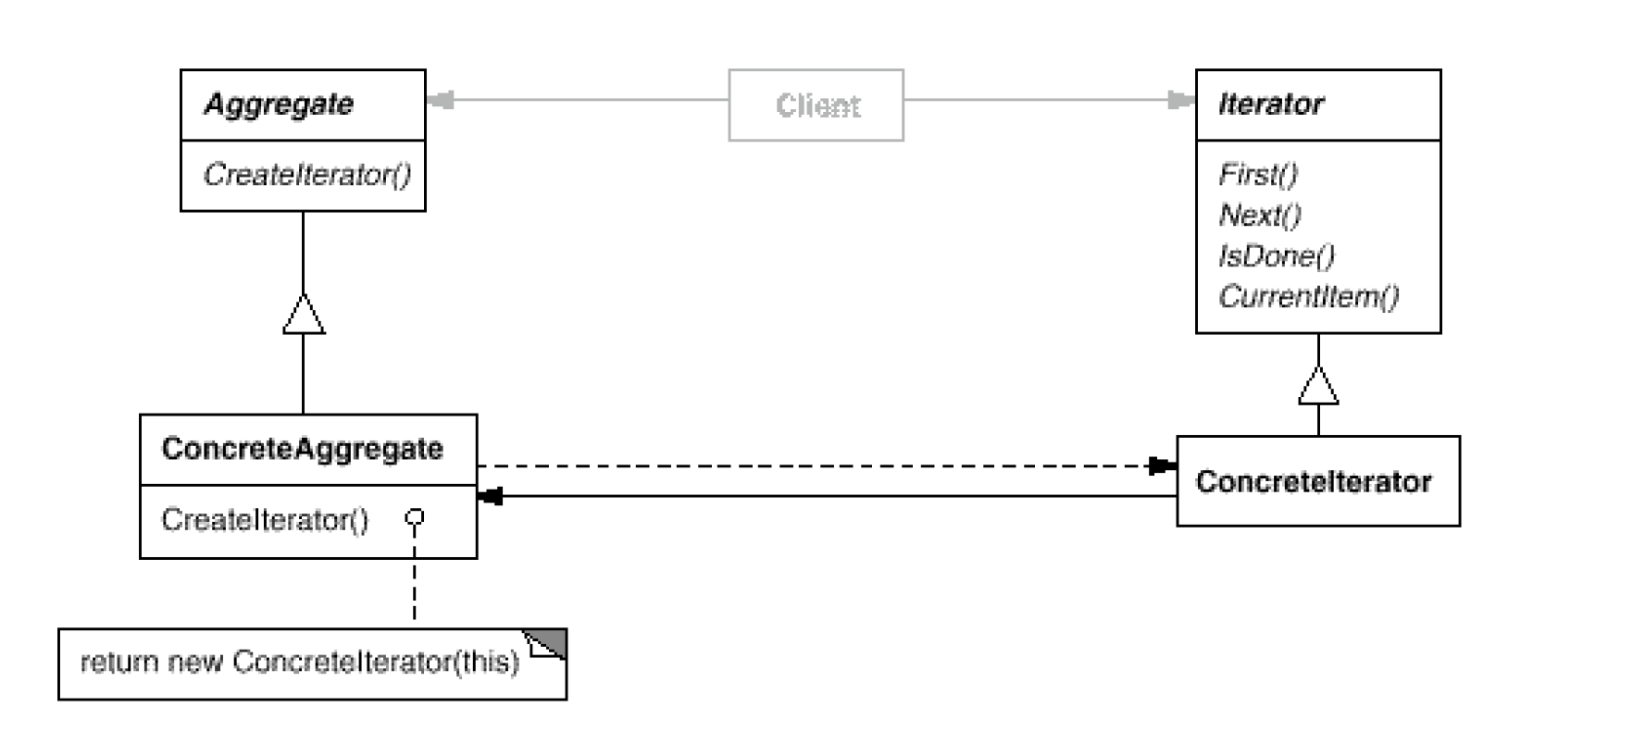
Iterator Pattern Structure
Source: Erich Gamma, Richard Helm, Ralph Johnson, and John Vlissides. 1995. Design Patterns: Elements of Reusable Object-Oriented Software. Addison-Wesley Longman Publishing Co., Inc., Boston, MA, USA.

Slide 6
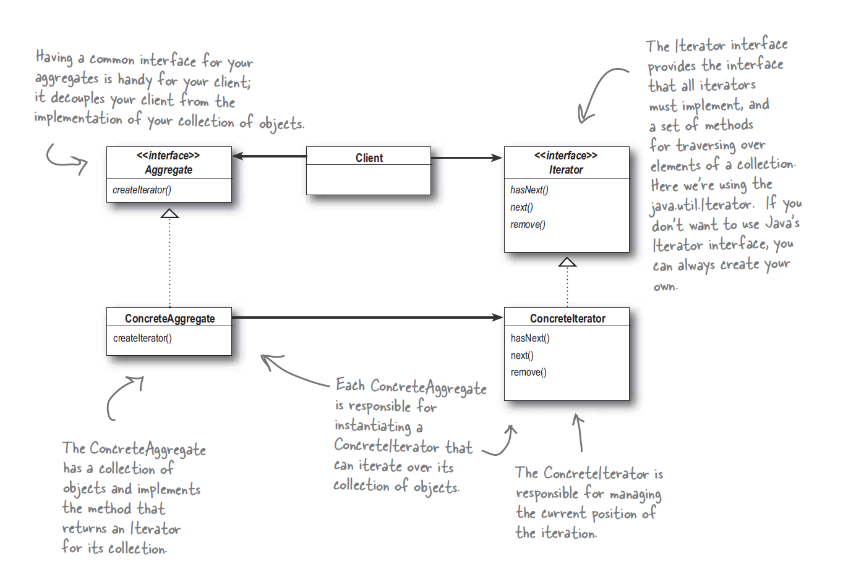
Iterator Pattern
Source: Freeman, E., Robson, E., Sierra, K., & Bates, B. (2004). Head First design patterns. Sebastopol, CA: O'Reilly.

Slide 7
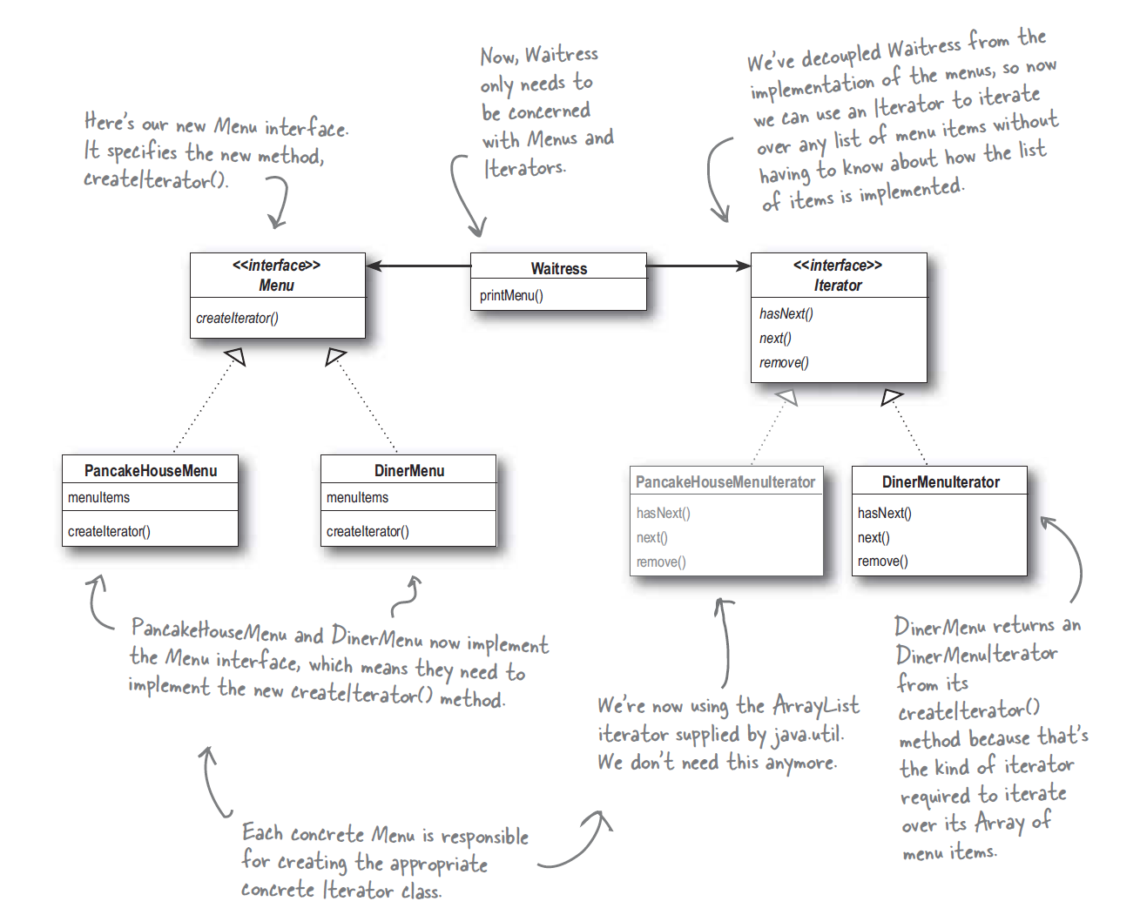
Iterator Pattern Sample
Source: Freeman, E., Robson, E., Sierra, K., & Bates, B. (2004). Head First design patterns. Sebastopol, CA: O'Reilly.

Slide 8
Consequences
It supports variations in the traversal of an aggregate.
Complex aggregates may be traversed in many ways. (i.e. in-order, pre-order; just replace the iterator with different one)
Iterators simplify Aggregate interface.
No need to implement traversal logic in the aggregate object.
More than one traversal can be pending on an aggregate.
An iterator keeps track of its own traversal state.
You can have more than one traversal in progress at once.

Slide 9
State
Intent:
Allow an object to alter its behavior when its internal state changes.
The object will appear to change its class.

Slide 10
Applicability
Use the State pattern when:
An object's behavior depends on its state, and it must change its behavior at run-time depending on that state.
Operations have large, multi-part conditional statements that depend on the object's state.
This state is usually represented by one or more enumerated constants.
Often, several operations will contain this same conditional structure.
The State pattern puts each branch of the conditional in a separate class.

Slide 11
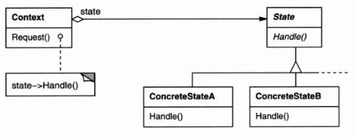
Structure

Slide 12
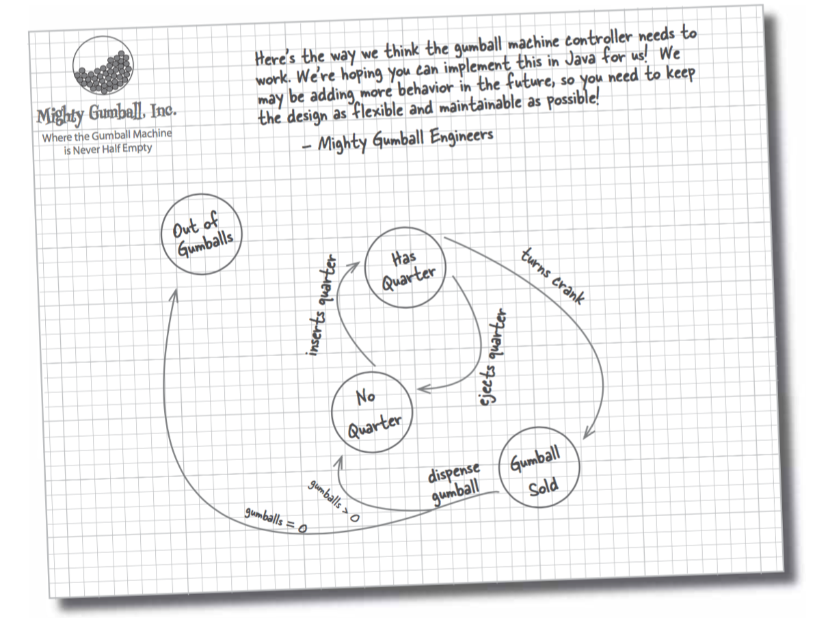
State

Slide 13
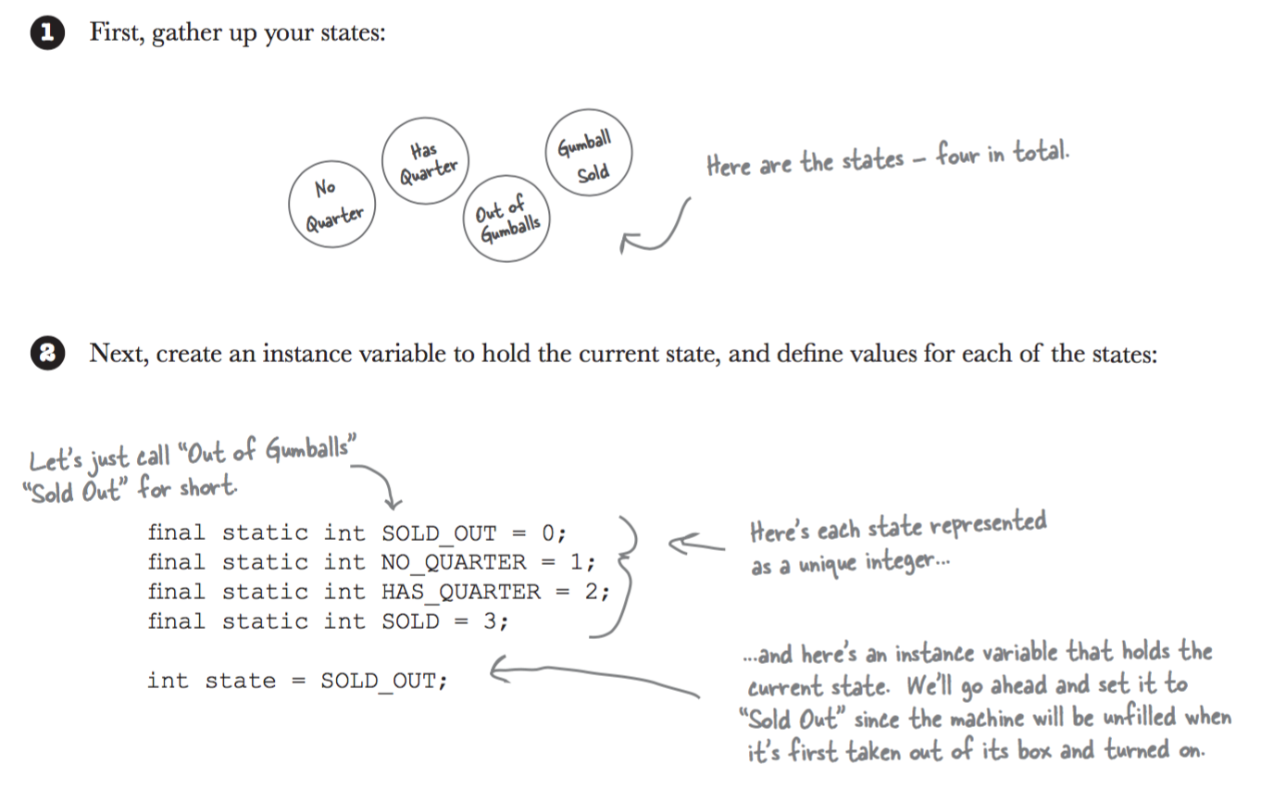
State

Slide 14
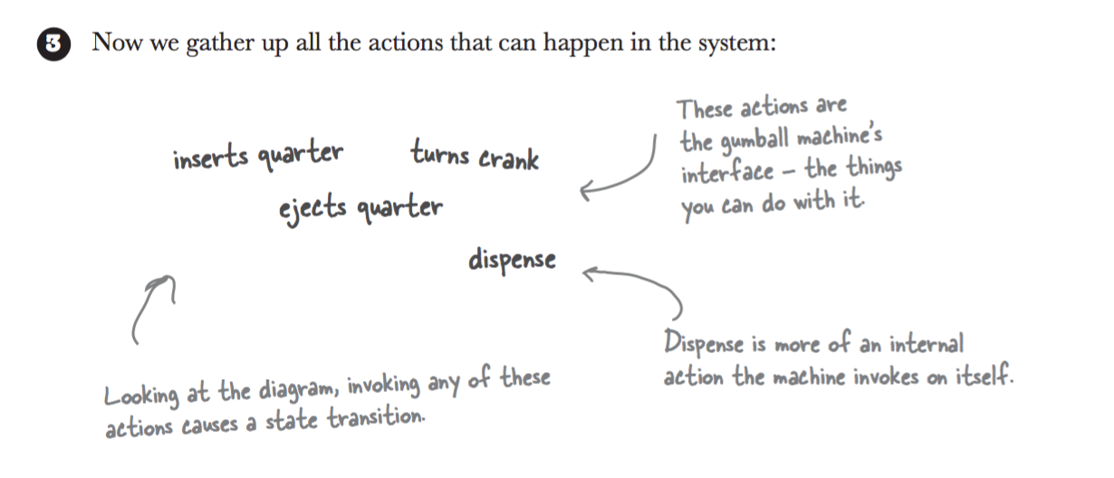
State

Slide 15
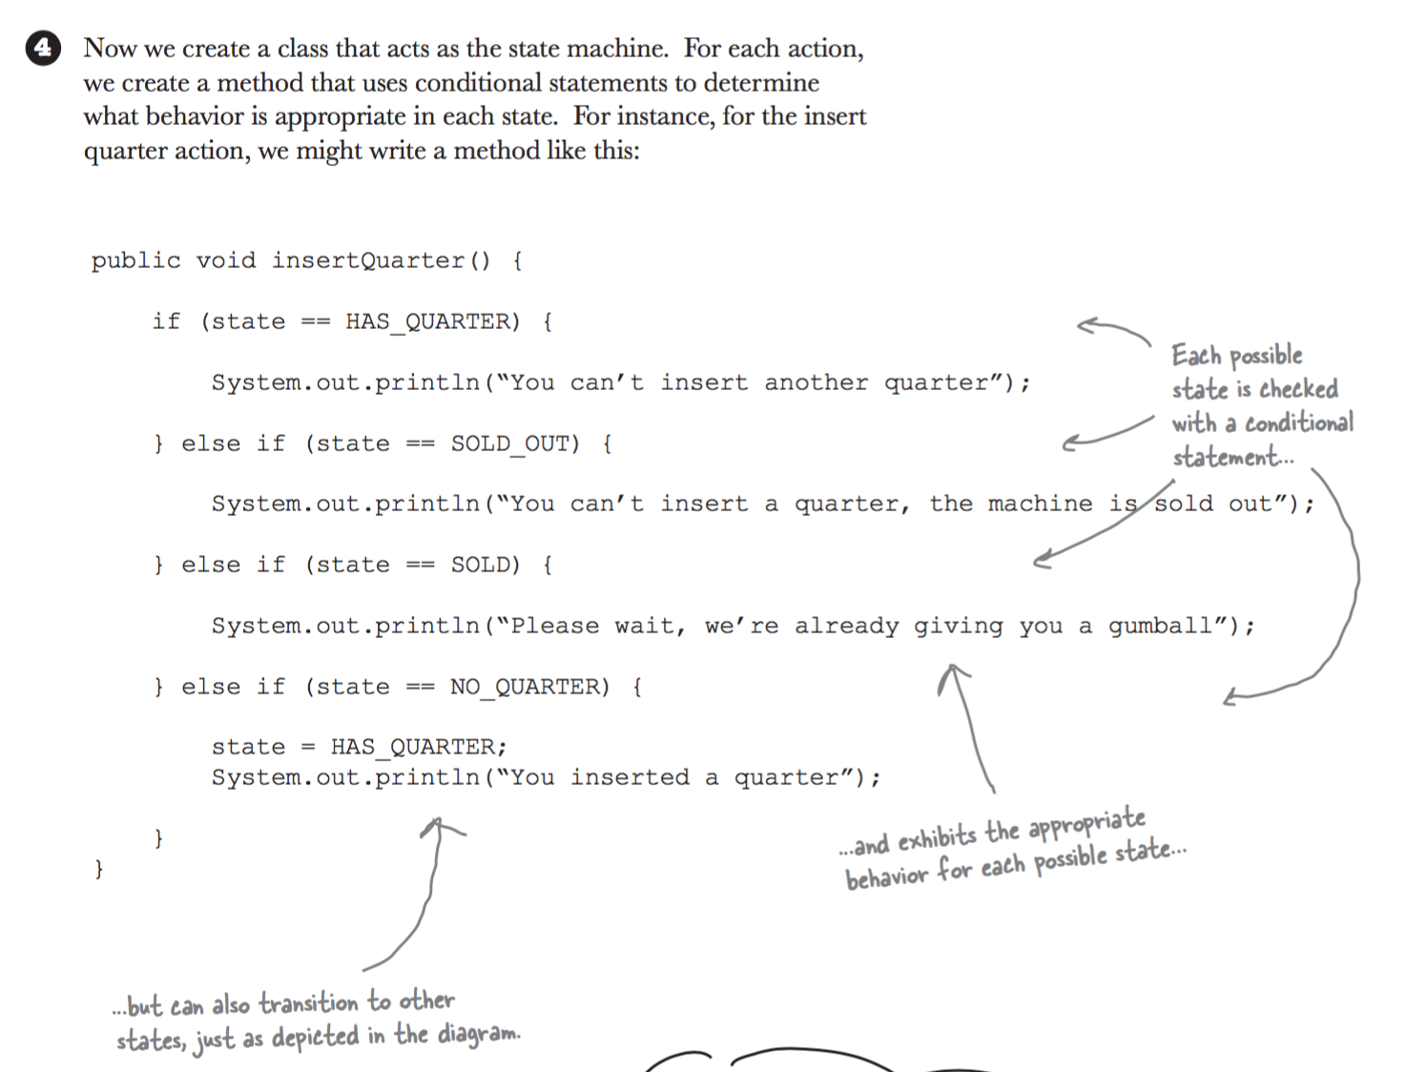
State

Slide 16
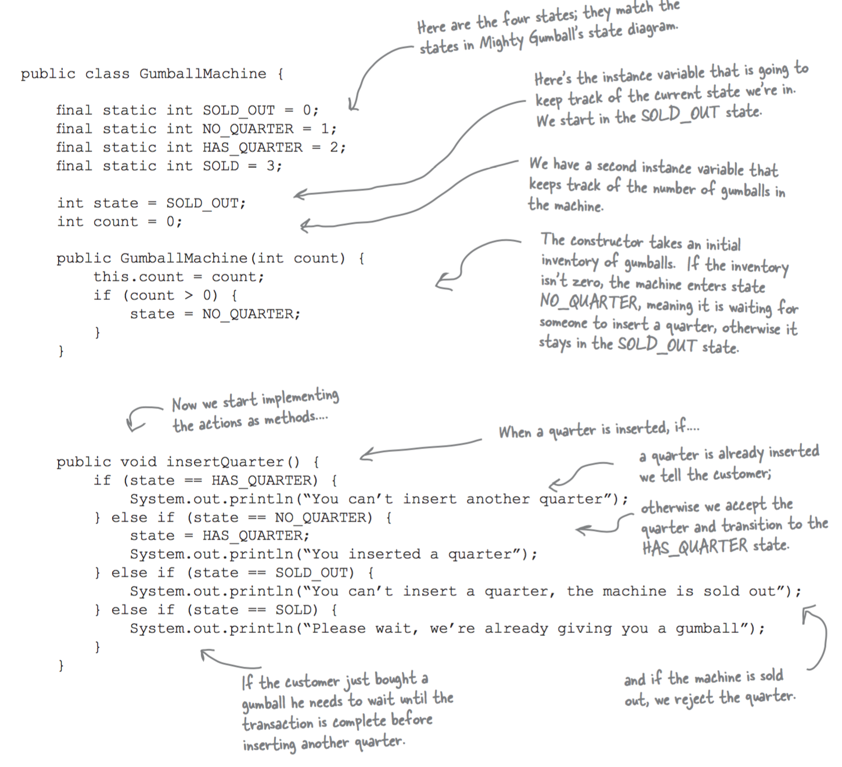
State

Slide 17
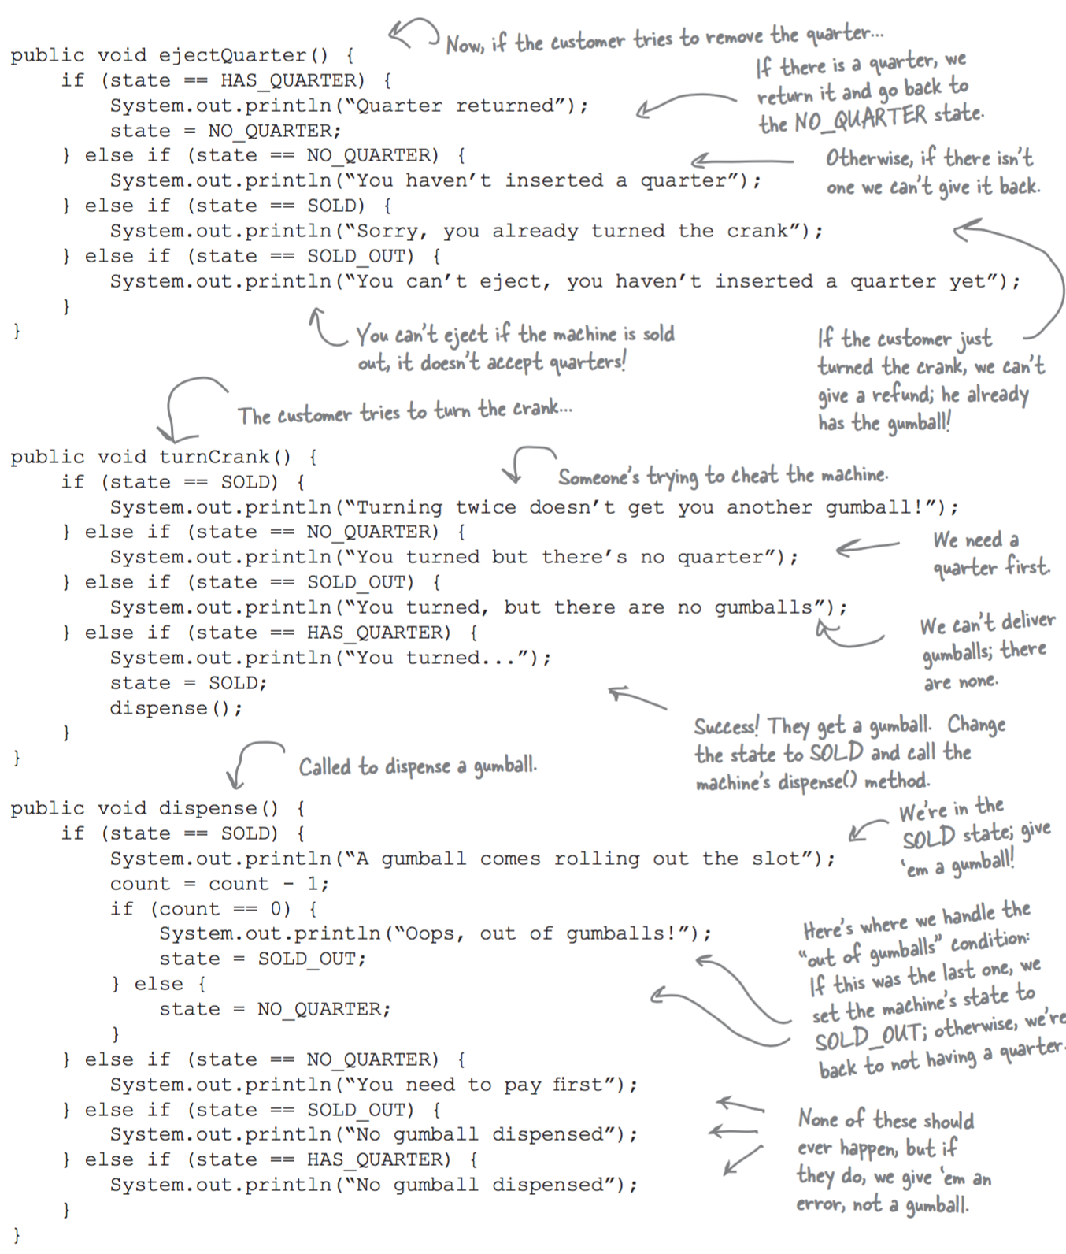
State

Slide 18
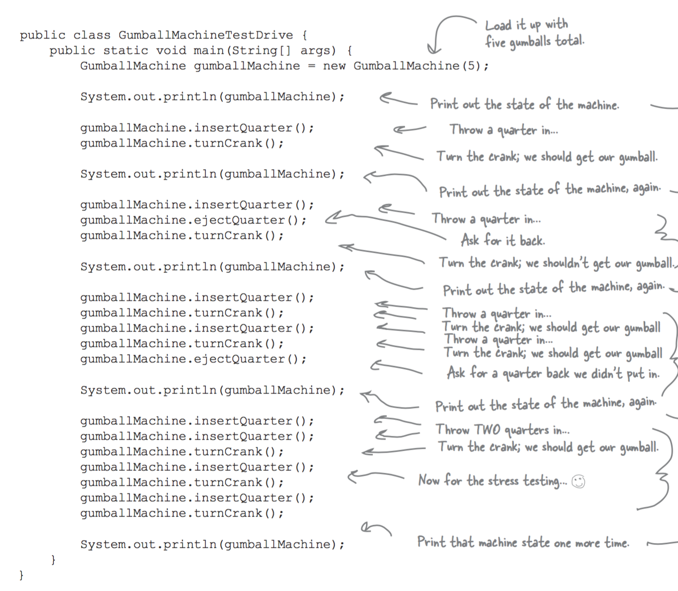
State

Slide 19
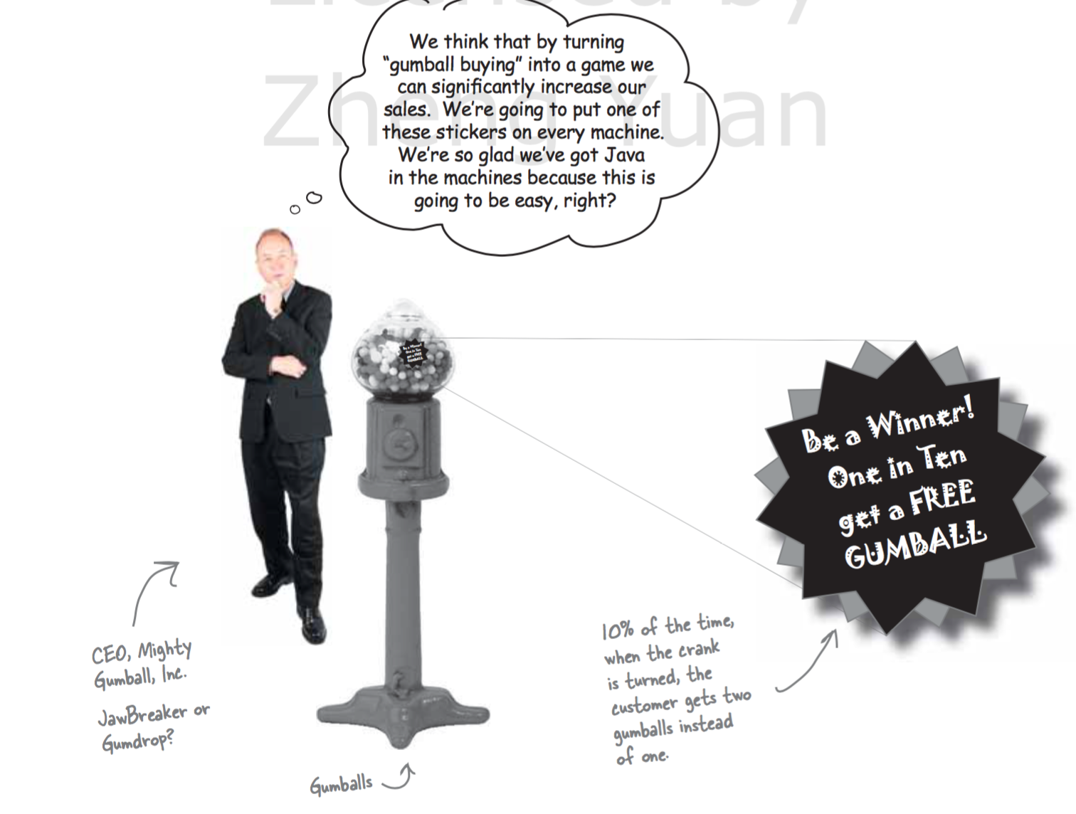
State

Slide 20
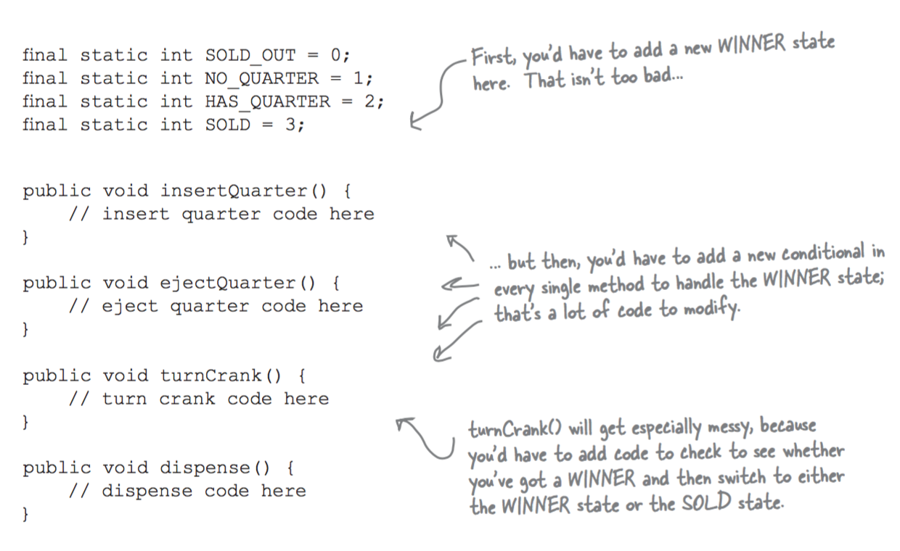
State

Slide 21
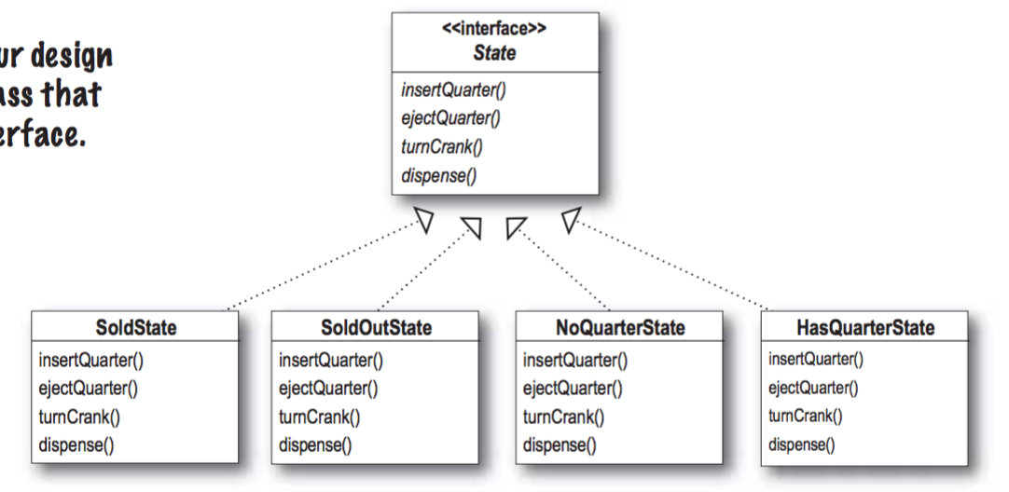
State

Slide 22
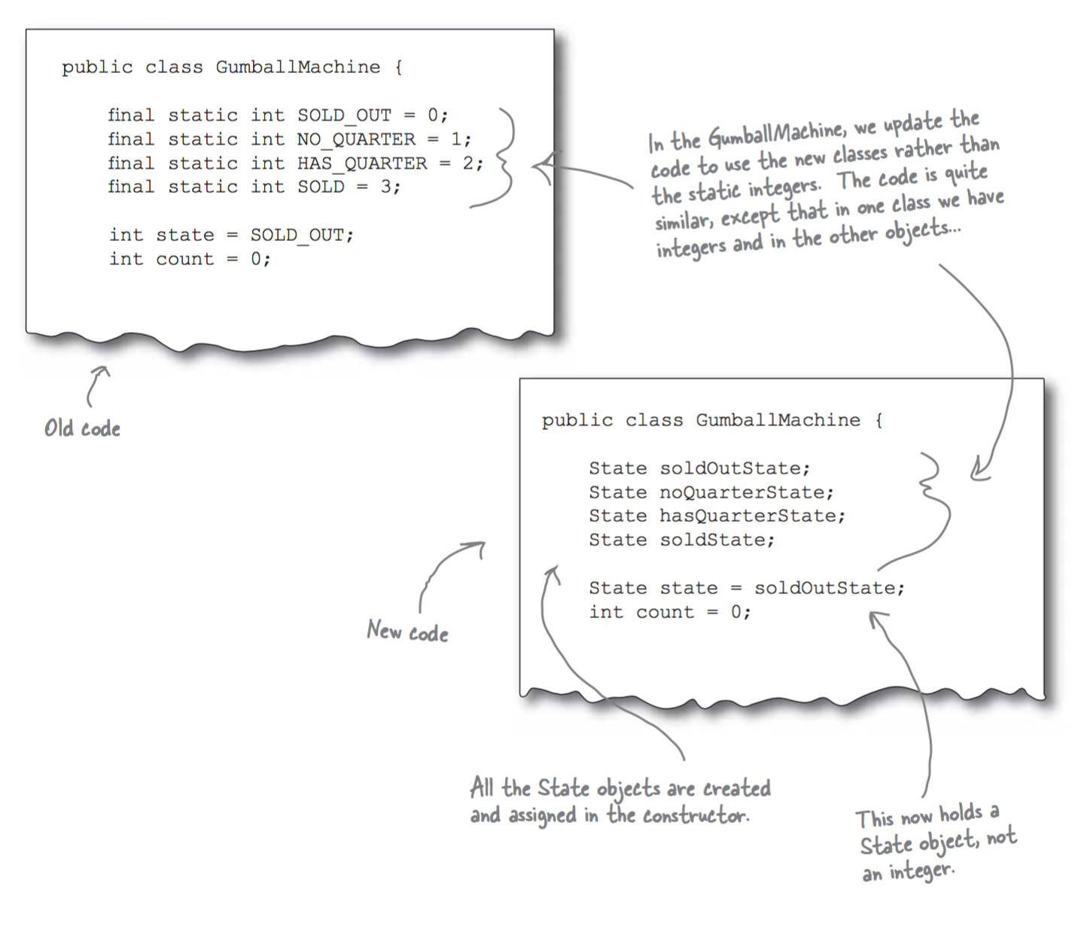
State

Slide 23
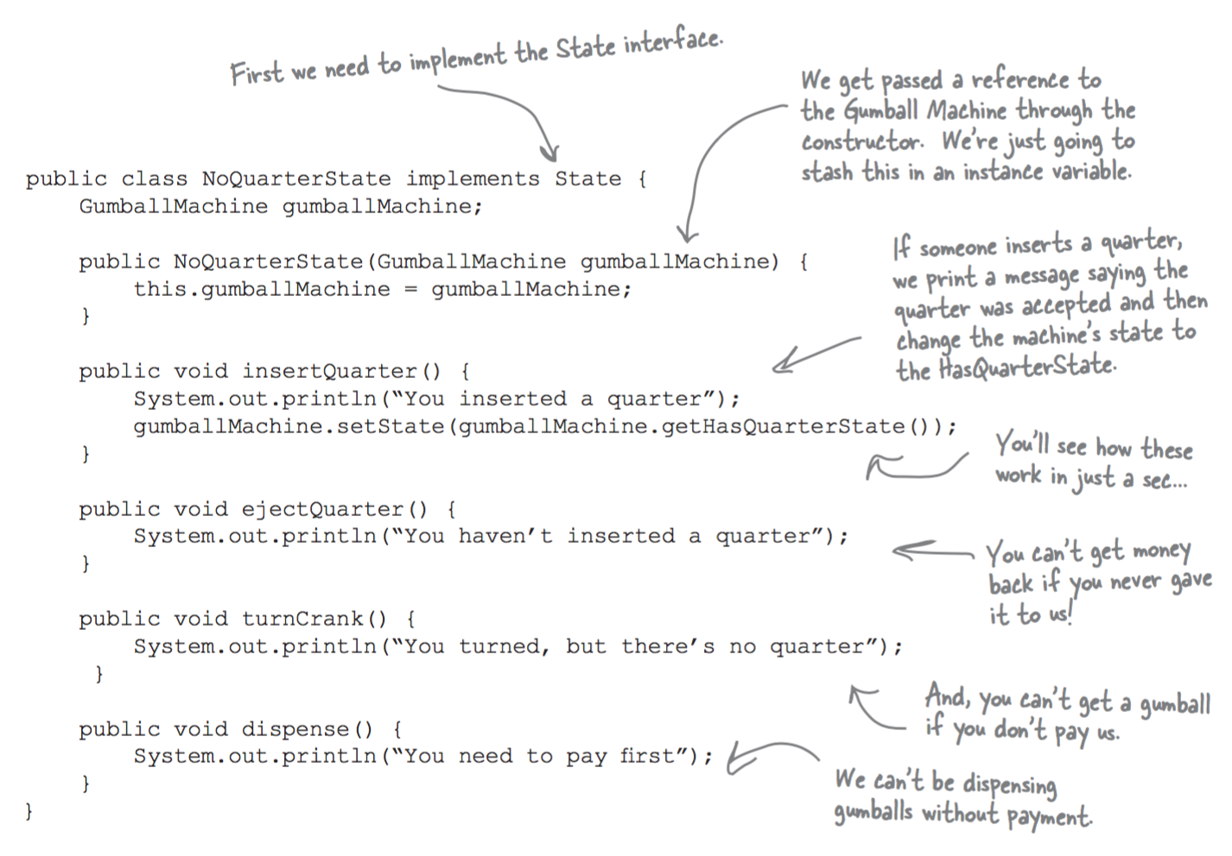
State

Slide 24
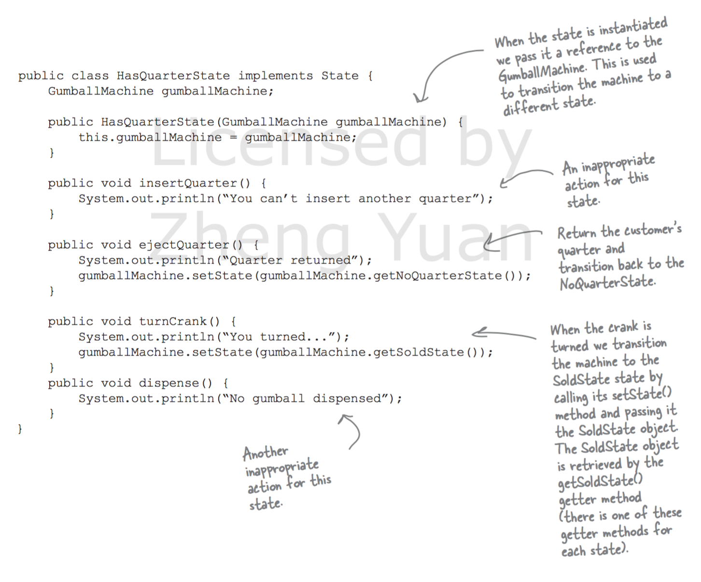
State

Slide 25
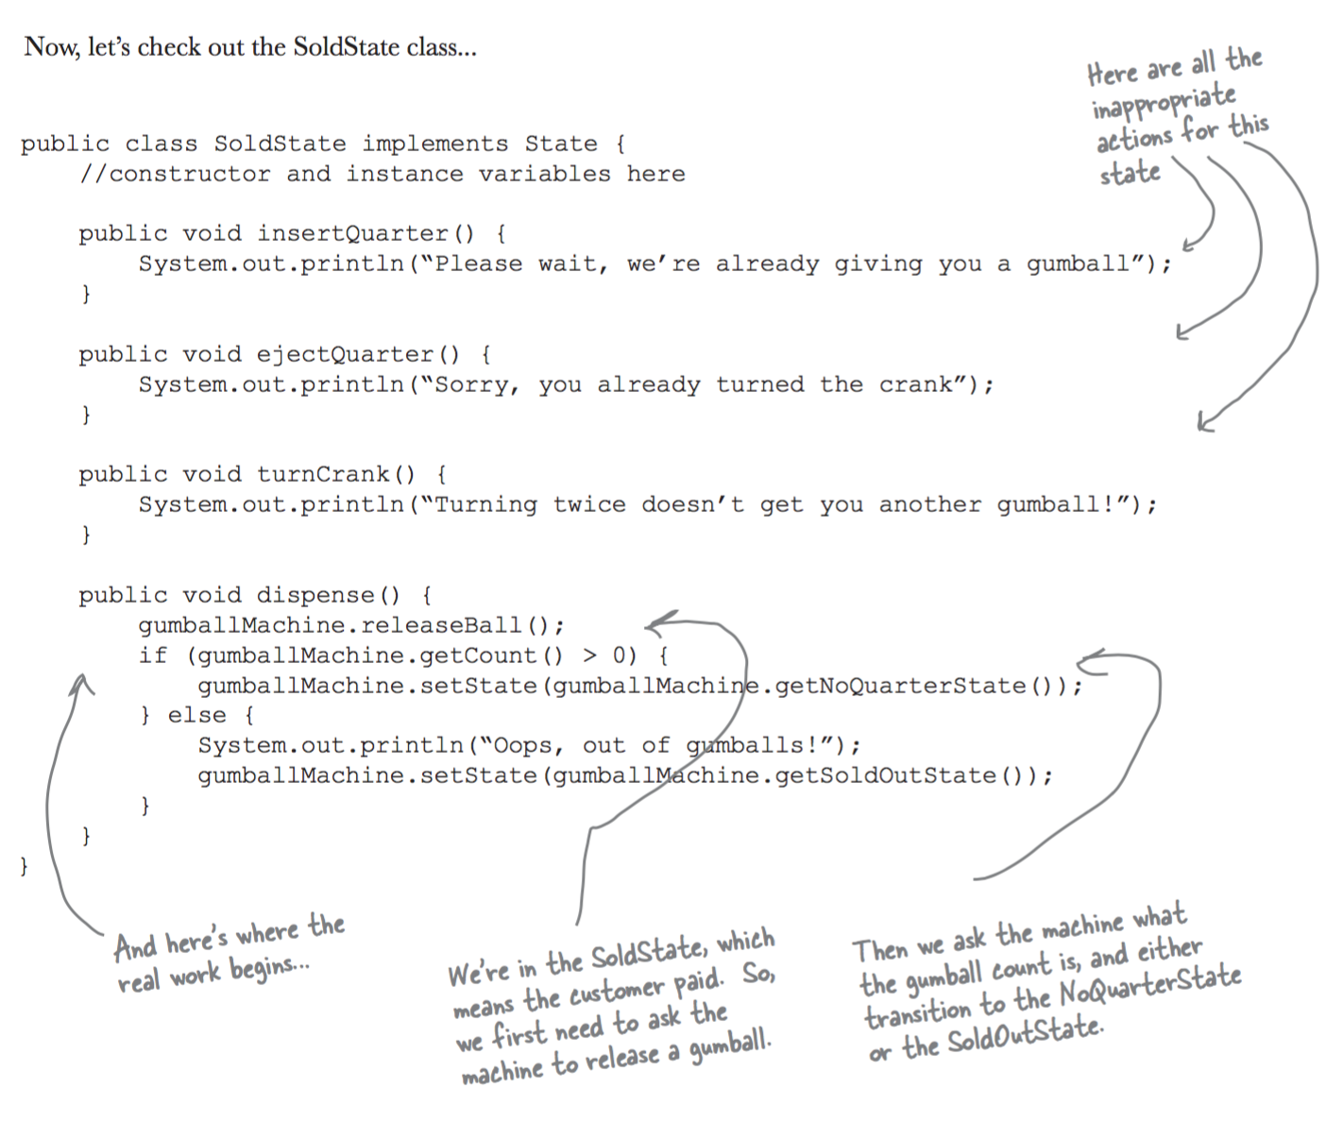
State

Slide 26
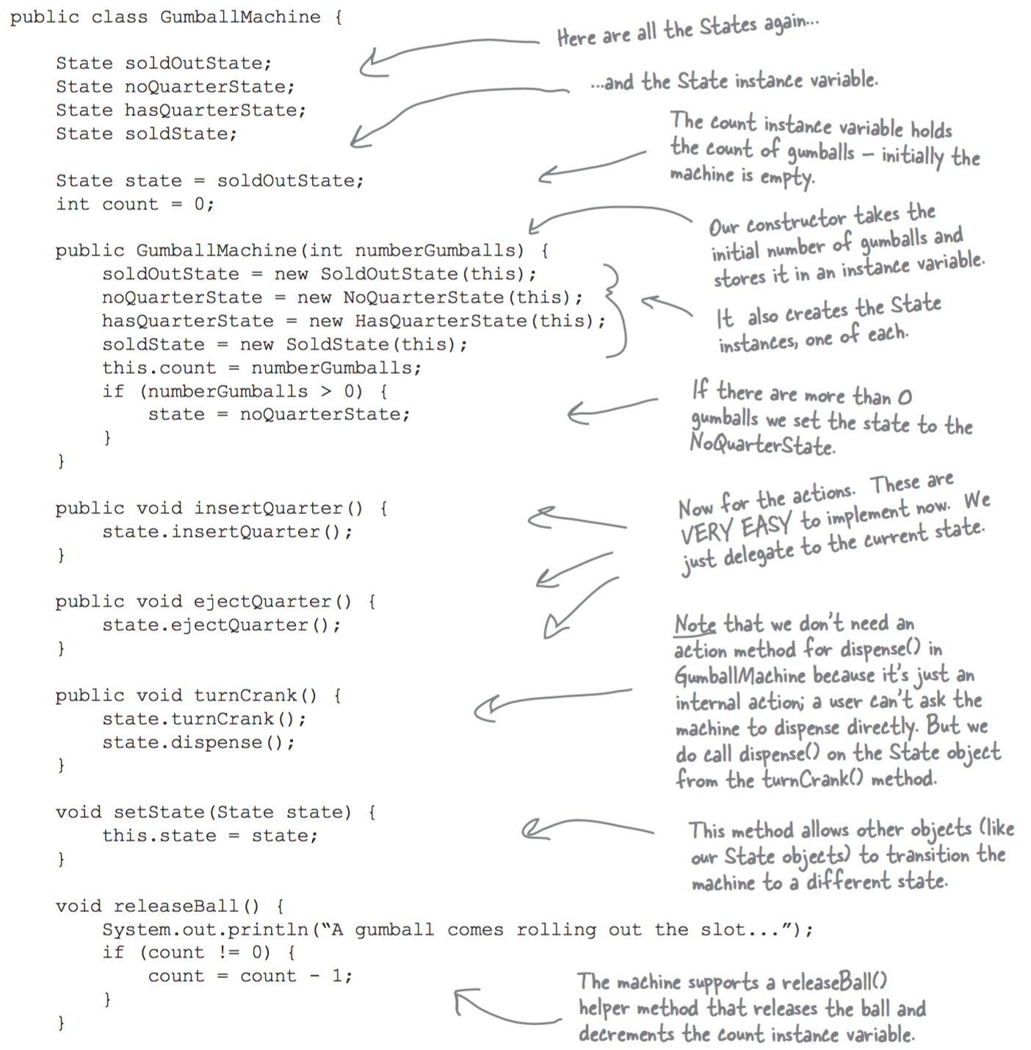
State

Slide 27
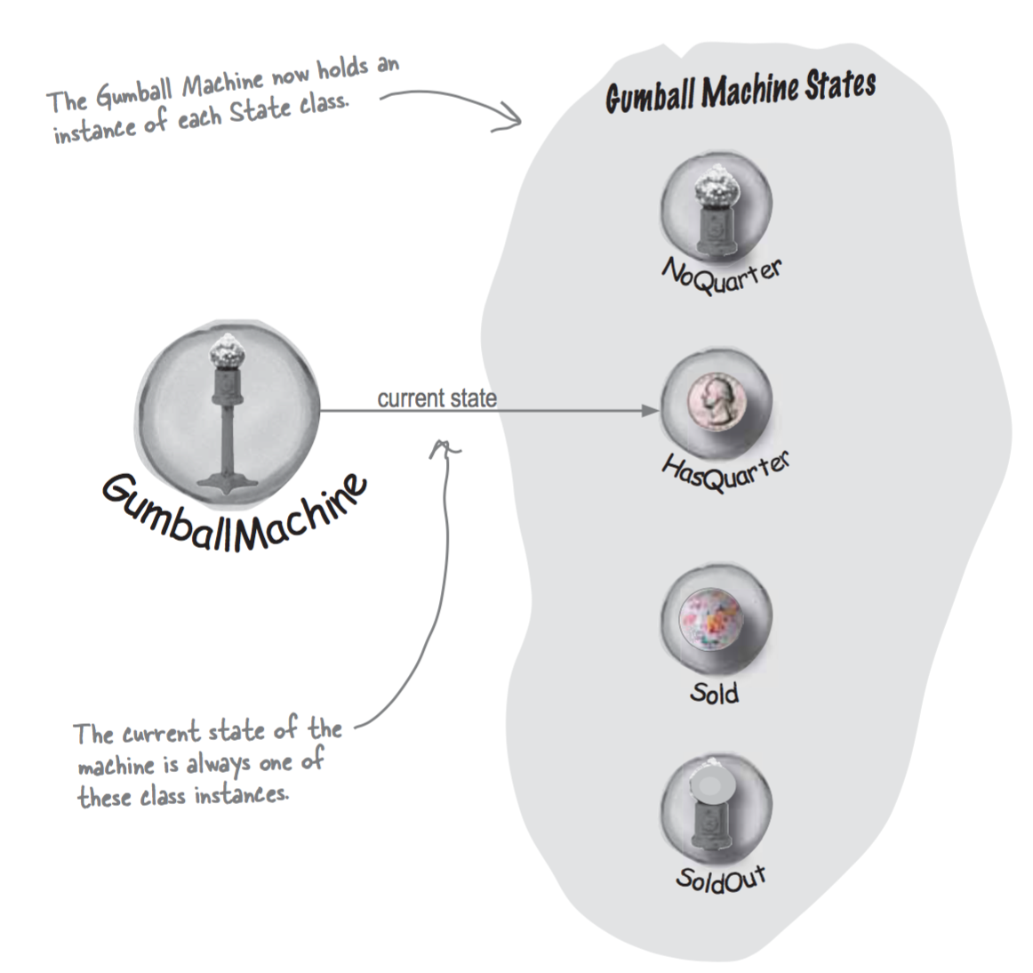
State

Slide 28
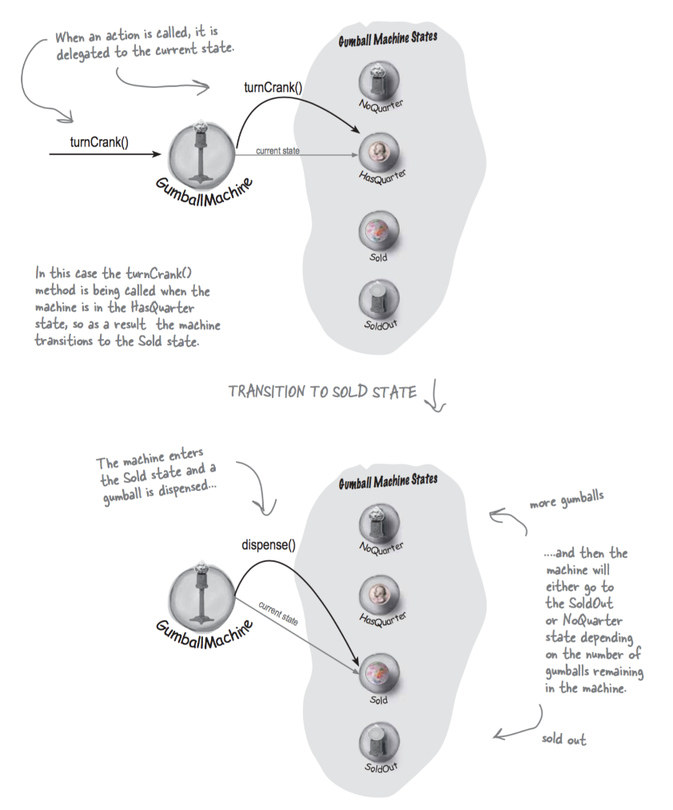
State

Slide 29
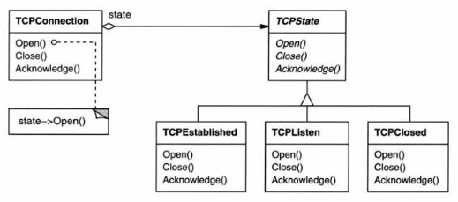
Example
TCP Connection
Established, Listening, Closed
Different reaction to requests based on state

Slide 30
Collaborations
Context delegates state-specific requests to the current ConcreteState object.
Context may pass itself as an argument to the State object handling the request.
Context is the primary interface for clients. Clients can configure a context with State objects.
Either Context or the ConcreteState subclasses can decide which state succeeds another and under what circumstances.

Slide 31
Consequences
The State pattern puts all behavior associated with a particular state into one object.
Because all state-specific code lives in a State subclass, new states and transitions can be added easily by defining new subclasses.
If-statements: Centralized in a single class. However, requires changing multiple locations when a new state is added.
Might be preferred if few, stable states.

Slide 32
Consequences
It makes state transitions explicit.
When an object defines its current state solely in terms of internal data values, its state transitions only show up as assignments to some variables.
State objects can be shared.
If they have no instance variables

Slide 33
Implementation
Creating and destroying state objects
Create on demand, destroy immediately
Create initially, never destroy.
State Objects are usually Singletons.

Slide 34
Implementation
Who defines the state transitions?
Context: Less flexible. Has to know all concrete states. Centralized control.
State classes: Increases inter-class dependencies.
Using table to map data/input to a state
Separate state transition, action mechanism from the actual data
Table lookup may be inefficient
Transitions are less explicit, harder to understand

Slide 35
Mediator Pattern
Mediator pattern is used to reduce communication complexity between multiple objects or classes.
Mediator handles all the communications between different classes.
Allows loose coupling by encapsulating the way distinct sets of objects interact and communicate with each other.
Allows for the actions of each object set to vary independently of one another.
Define an object that encapsulates how a set of objects interact.
keeping objects from referring to each other explicitly!

Slide 36
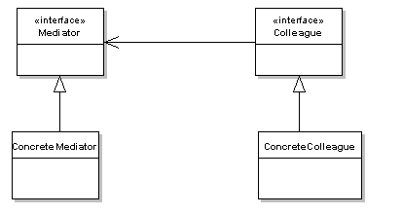
Mediator Pattern Structure

Slide 37
Mediator Pattern
The participants classes in this pattern are:
Mediator - defines an interface for communicating with Colleague objects.
ConcreteMediator - knows the colleague classes and keep a reference to the colleague objects.
implements the communication and transfer the messages between the colleague classes
Colleague classes - keep a reference to its Mediator object
communicates with the Mediator whenever it would have otherwise communicated with another Colleague.

Slide 38
Mediator Pattern
Mediator Pattern should be used when:
a set of objects communicate in well-defined but complex ways. The resulting interdependencies are unstructured and difficult to understand.
reusing an object is difficult because it refers to and communicates with many other objects.
a behavior that's distributed between several classes should be customizable without a lot of sub classing.

Slide 39
Consequences
Advantages
Comprehension - The mediator encapsulate the logic of mediation between the colleagues. Easier to understand the logic since it is kept in only one class.
Decoupled Colleagues - The colleague classes are totally decoupled. Adding a new colleague class is very easy due to this decoupling level.
Simplified object protocols - The colleague objects need to communicate only with the mediator objects. Reduces the required communication channels (protocols) from many to many to one to many and many to one.
Limits Sub classing - Because the entire communication logic is encapsulated by the mediator class, when this logic need to be extended only the mediator class need to be extended.
Disadvantages
Complexity - In practice the mediators tends to become more complex. A good practice is to take care to make the mediator classes responsible only for the communication part.

